Slide 1
An Analysis of Emphasis in Najdi Arabic
Repurposing of Linguistic Research for Applied Mathematics

Slide 2
Arabic – Macrolanguage
Arabic has covered a significant territory from the Umayyad Caliphate onward, 660s CE.
Like Latin, the spoken language diverged over time.
There is religious and political impetus to continue to consider Arabic as a single language.
Mutually unintelligible varieties used for daily speech spanning from northwestern Africa to Indian subcontinent.

Slide 3
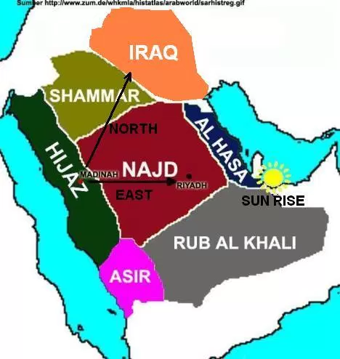
Najd
Central plateau
Riyadh is there now
Major population center
Historically very sparsely populated

Slide 4
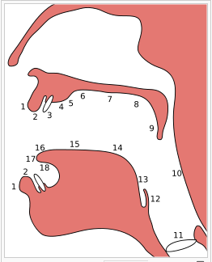
Emphatic Consonants
Alveolar consonants: blade of tongue at 4
Four consonants: س د ت ذ ð t d s ص ض ط ظ
Pharyngeal coarticulation: root of tongue toward 10

Slide 5
About Pronunciation
These consonants are phonemic in Arabic. There are words that differ only in the quality of these consonants. /sayf/ صيف summer /sˁayf/ سيف sword
They are typically a significant issue for learners of Arabic.

Slide 6
Initial Study Proposal
Survey of this variety of Arabic
Phonetic inventory
Contrast with the other varieties:
Yemeni
Levant
Egyptian
Gulf
Recruitment Difficulties

Slide 7
Recordings
IRB approved
Six subjects, native to Najd
Primarily university students, male, in their 20s
Word list recording
Controlled
Static / self-aware
“Careful” speech

Slide 8
Wordlist
Primarily focusing on the emphatic consonants.
Arabic has contrastive vowel length. Only 3 vowels: a i u
The long vowels are noted in orthography, matres lectionis. Short vowels vary widely.
Wordlist was constructed to highlight emphatic consonants with long vowels.
Likely evidence of coarticulation in vowel quality.

Slide 9
Praat
Praat is free software for acoustic analysis, developed by Paul Boersma and David Weenink
Support for spectral analysis:
Formants using FFT
Pitch, Intensity, Jitter, etc
Segmentation of sound files and labeling
Programmable
Distributed on http://www.praat.org

Slide 10
Processing
Manual annotation of the recordings.
Programmatic retrieval of data using Praat.
For consonants, first four moments: center of gravity, standard deviation, kurtosis, and skewness
Measurements twice: with and without Hann band pass and pre-emphasis filters (Miller-Ockhuizen & Sands, 1999)

Slide 11
Processing
For vowels, first three formants, primary vocalic characteristics. Divided into 10 equal segments, formants measure mid-segment.
Establish slope and mean values for onset (first 30%), steady-state (middle 40%), and possible off-glide (final 30%)
Slope calculated using linear least-squares, using Python, the numpy package.

Slide 12
Analysis
Compare the consonantal measurements
Compare the vowel measurements
Wordlist problem, lack of CV combinations for non-emphatics
Focus on /sˁ/ and /tˁ/ due to /dˁ/ variability and /ðˁ/ scarcity

Slide 13
Analysis I
Use a separate test word, consonant metrics
Results for /s/:
12 of 20 correct for emphatic
6 of 21 correct for non-emphatic
Overall: ~44% correct
Results for /t/:
12 of 20 correct for emphatic
19 of 20 correct for non-emphatic
Overall: 77.5% correct

Slide 14
Analysis II
Recognizing inter-speaker variability, consonants
Results for /s/:
17 of 20 correct for emphatic
4 of 21 correct for non-emphatic
Overall: ~44% correct
Results for /t/:
12 of 20 correct for emphatic
9 of 21 correct for non-emphatic
Overall: ~51% correct
Very small sample sizes

Slide 15
Analysis III
Use a separate test word, vowel metrics
Results for /s/:
15 of 21 correct for emphatic
20 of 20 correct for non-emphatic
Overall: ~85% correct
Results for /t/:
18 of 21 correct for emphatic
20 of 20 correct for non-emphatic
Overall: ~93% correct

Slide 16
Future Work
Repeat this work with a more carefully constructed word list to include non-emphatic / long vowel combinations.
LDA suggests what might be salient for distinguishing emphatic from non-emphatic consonants.
Create perception tests using native Arabic speakers, both Najdi and non-Najdi.

Slide 17
Analysis III
Recognizing coarticulation effects, consonants
Results for /s/:
59 of 62 correct for emphatic
5 of 20 correct for non-emphatic
Overall: ~78% correct
Results for /t/:
46 of 60 correct for emphatic
26 of 35 correct for non-emphatic
Overall: 77.5% correct

Slide 18
Analysis III
Recognizing coarticulation effects, vowels
Results for /s/:
17 of 20 correct for emphatic
4 of 21 correct for non-emphatic
Overall: ~44% correct
Results for /t/:
12 of 20 correct for emphatic
19 of 20 correct for non-emphatic
Overall: 77.5% correct

